Slide 1

Chatbot
Team Members:
Faizan Qazi 263118
Danial Ahmad 249912
Shariq Bin Rashid 242431
BSCS-8B

Slide 2

Problem statement
Online companies require extra employee to reply their customers.
Negotiating with them also take a lot of time.
It cost them very much as they usually need a separate call center and employees for this purpose.
The company need to hire double the employees as they need to be active 24/7.

Slide 3
Idea
Here our chatbot will provide these companies with the perfect solution.
It will reply customers in real time, help them find the best product.
It will also convince them to buy our product and chat with them with a humanly manner.
It will save them cost and time.
This will increase their productivity and efficiency.

Slide 4
Features
Data Size
60000+
Time Complexity
O(1) in average case
Data Structures Used
Dynamic Arrays
Linked lists
Hash tables

Slide 5
Features
Cont.
Algorithms Used
Hash functions
String filtering
Sorting
Stemming
lemmatization

Slide 6
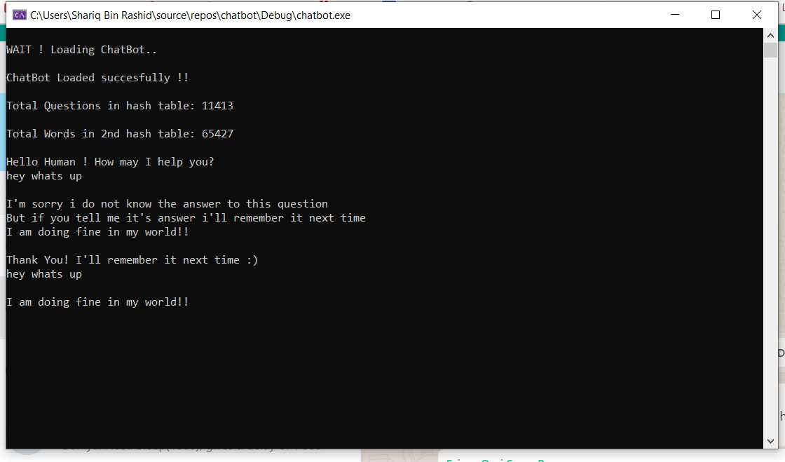

Slide 7
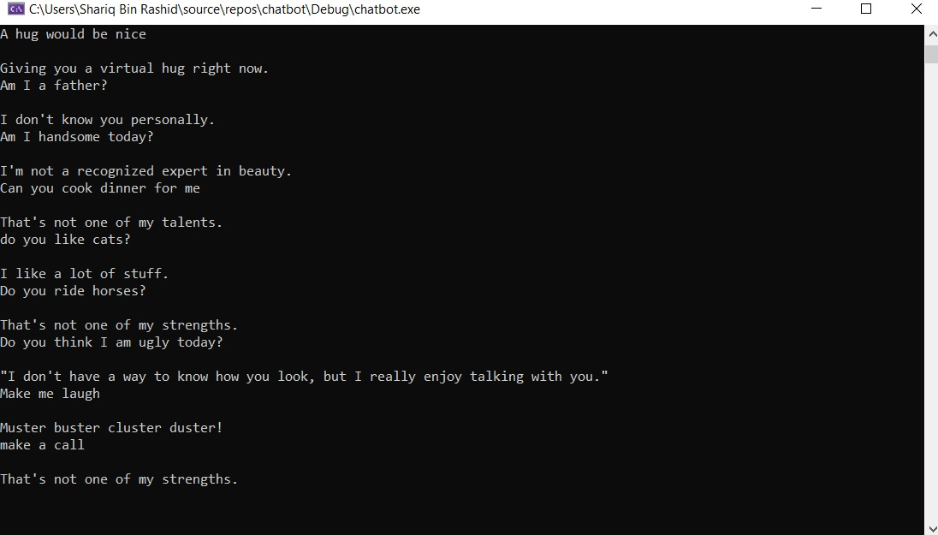

Slide 8
